Slide 1

Vehicle Management Database System
Tarun Badhan
Student ID: 3775318
CS 1103

Slide 2
Introduction
• Database systems manage data efficiently
• Vehicle Management System
• Built using Java and SQLite
• Manages vehicles, owners, service records

Slide 3
Objectives
• Manage vehicle data
• Link vehicles to owners
• Track service history
• Perform CRUD operations

Slide 4
Technologies Used
• Java (JDBC)
• SQLite
• SQL

Slide 5
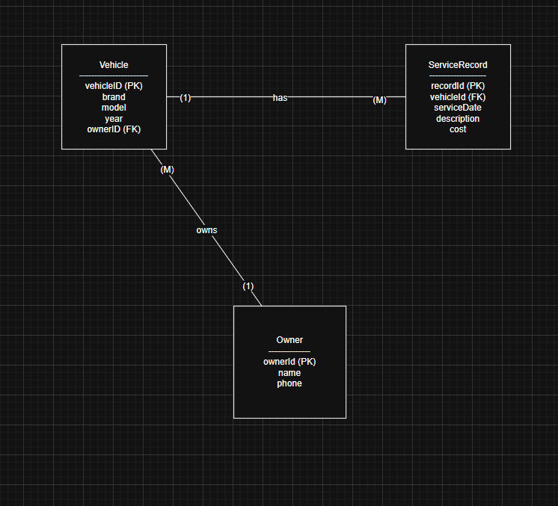
ER Diagram
• Owner, Vehicle, ServiceRecord
• One-to-many relationships
• Foreign keys

Slide 6
Database Design
• Tables: Owner, Vehicle, ServiceRecord
• Primary keys
• Foreign keys
• SQL schema

Slide 7
SQL Operations
• INSERT
• SELECT
• UPDATE
• DELETE

Slide 8
Java Application
• Menu-driven console app
• Uses JDBC
• Performs CRUD operations

Slide 9
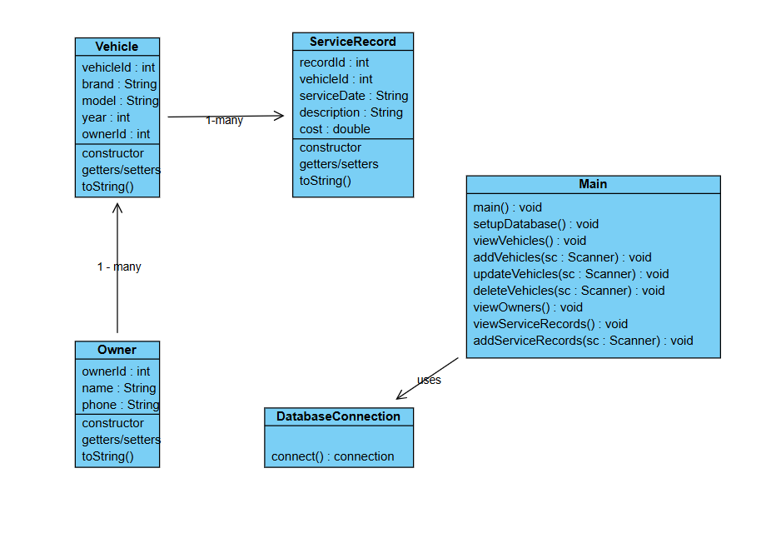
Class Diagram
Main + DatabaseConnection
Organized Structure

Slide 10
Conclusion
• System implemented successfully
• Demonstrates database and Java integration
• Can be extended in future

Slide 11
Thank You

